Slide 1
Phase of project Front-end web development

Slide 2
Languages used : HTML & CSS
Without Login Version

Slide 3
Without Log in
-if new patient without log in can make an appointment and contact the clinic.
-new patient take a serial number from admin to login.
-patient can log in with serial number(password) and name.

Slide 4
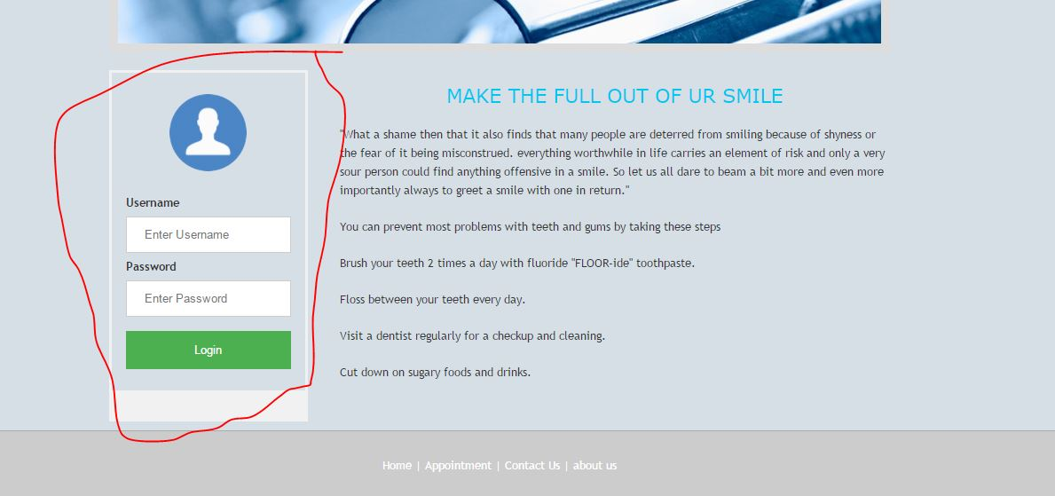
Form log in

Slide 5
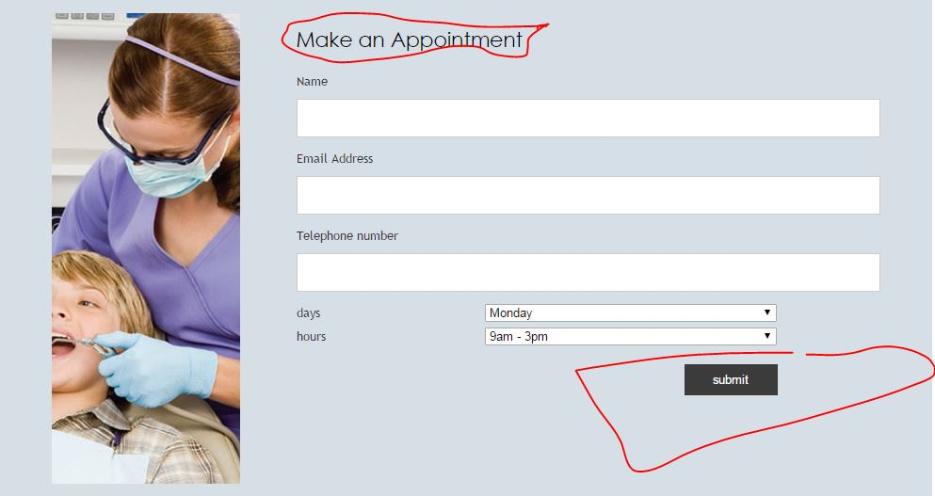
Make an appointment, why you wait ?!!

